Slide 1

Are you talking to me?
Renée Hlozek
Princeton University
2014 TED Senior Fellow
@reneehlozek http://reneehlozek.moonfruit.com/

Slide 2
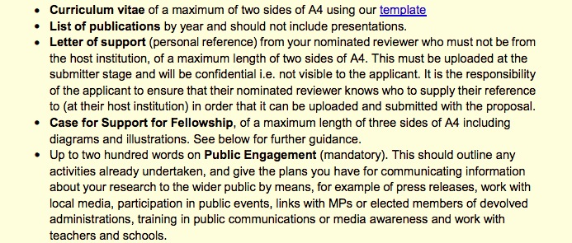
The doing and talking of science

Slide 3
The cart and the horse
New generation scientists see communication as passion in addition to ‘beneficial’
E.g. Princeton Astrophysics new grad student outreach request

Slide 4
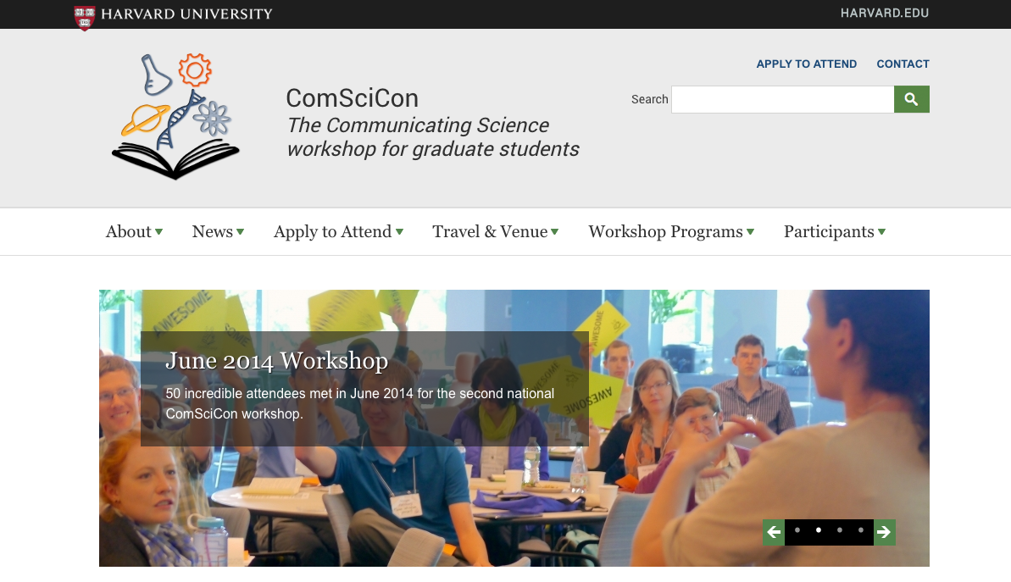

Slide 5
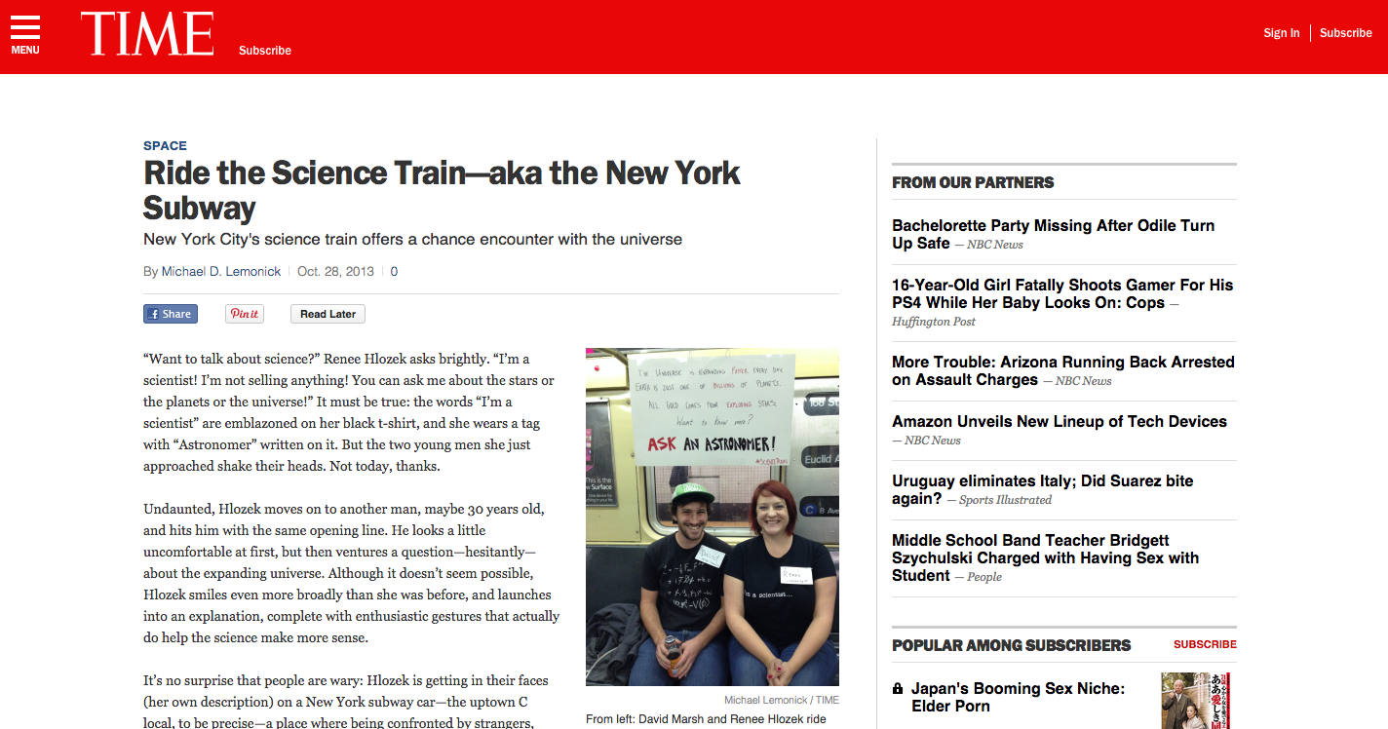

Slide 6
Why do we communicate?
Public interest yields funding
Desire to give back and inform
Simply sharing the joy of what we do

Slide 7
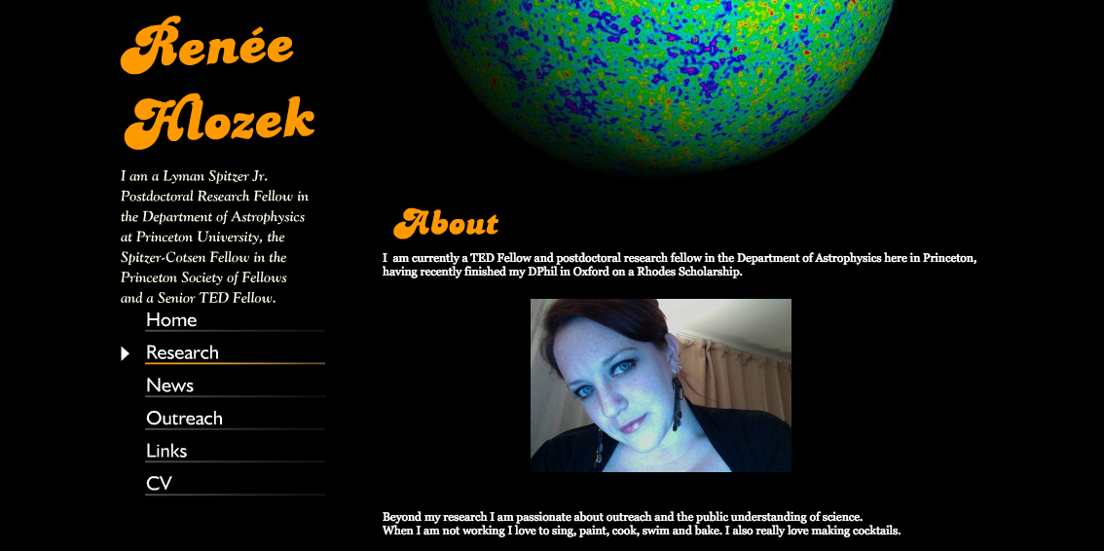
How do we communicate?

Slide 8
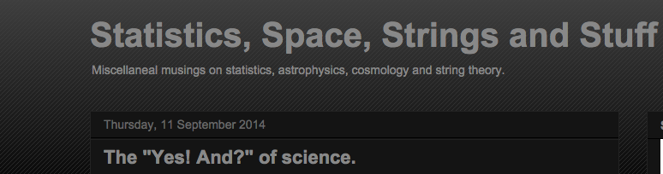
How do we communicate?

Slide 9
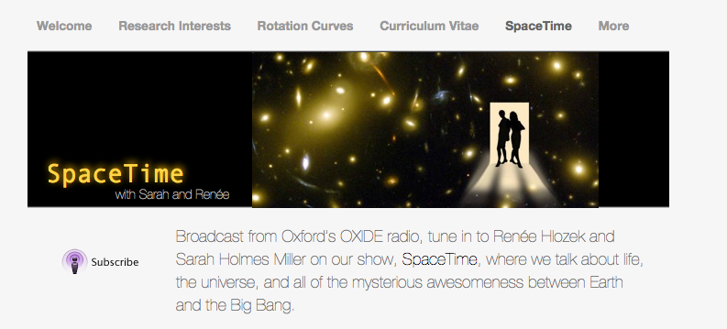
How do we communicate?

Slide 10
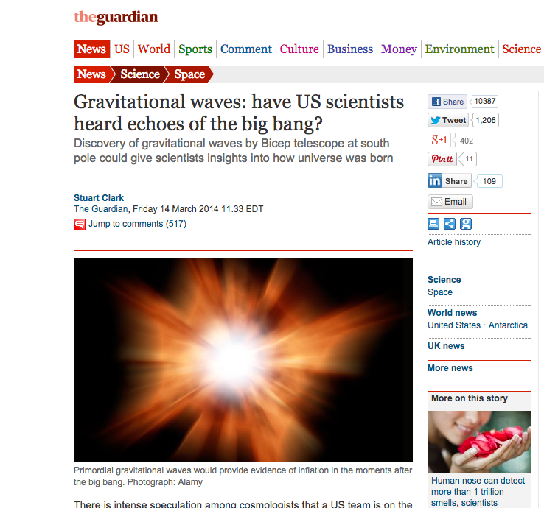

Slide 11
Inward not outward
So many users of the webcast that it crashed
Community tweeted throughout the conference
> 3000 #BICEP2 tweets

Slide 12
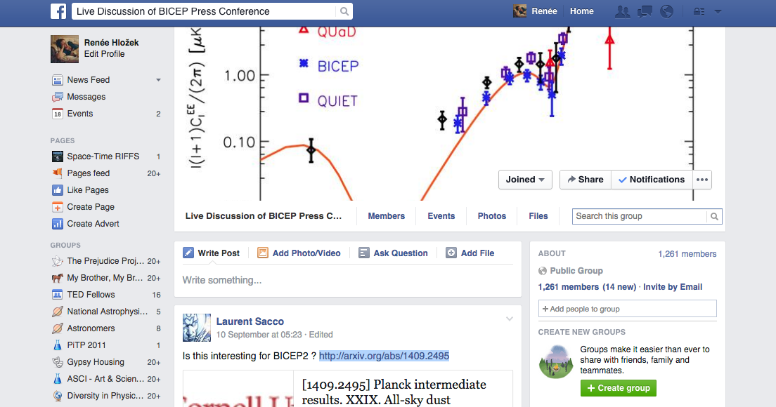
BICEP2 Facebook group
1261 members of the community

Slide 13
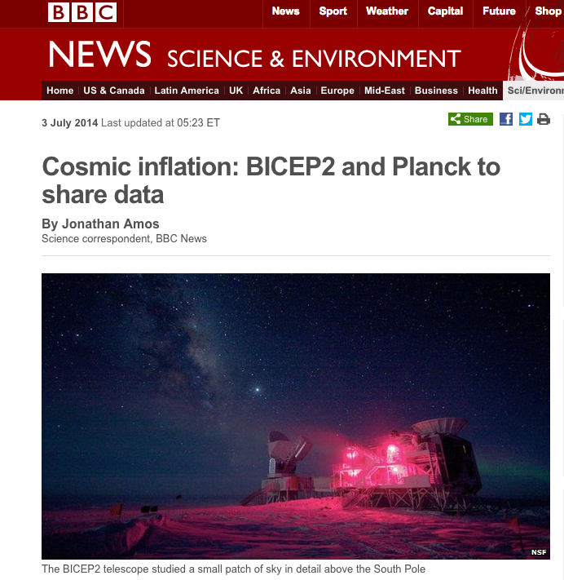
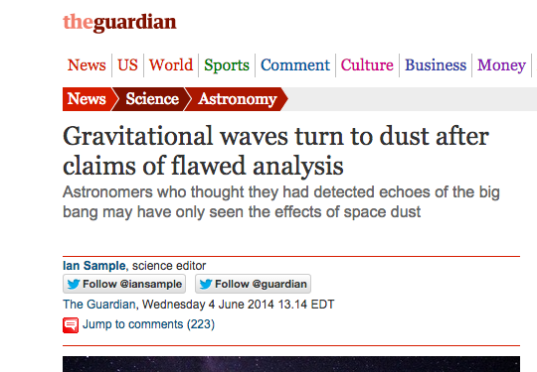

Slide 14
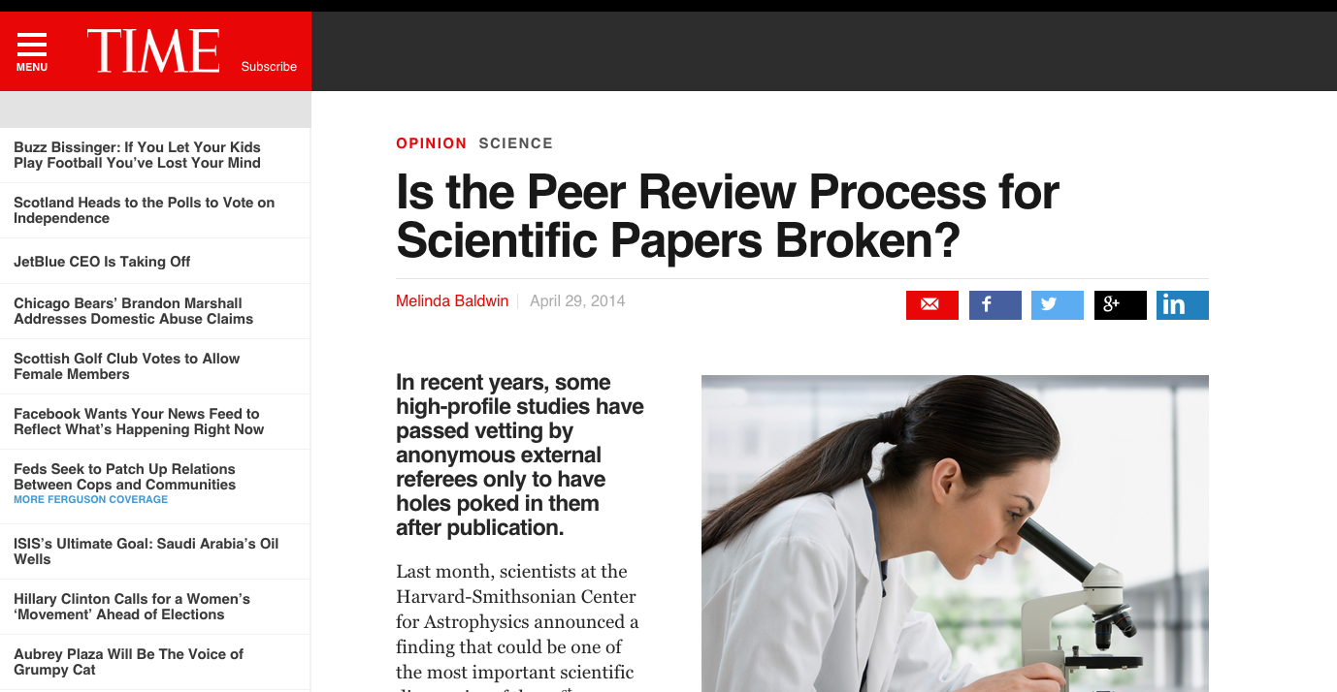

Slide 15
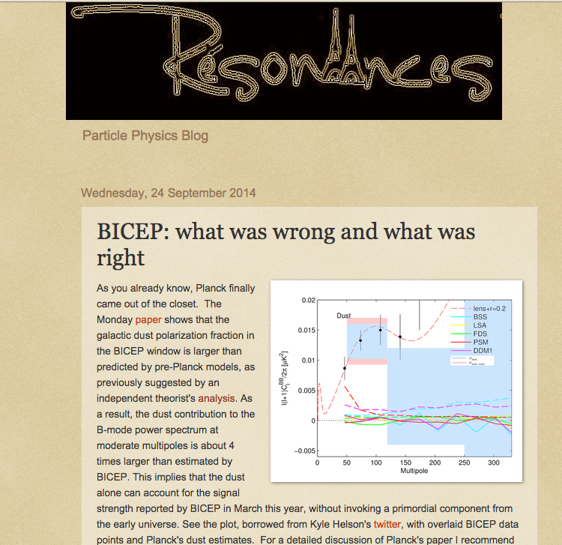
Research Meta-analysis

Slide 16
We are not in Kansas anymore...

Slide 17
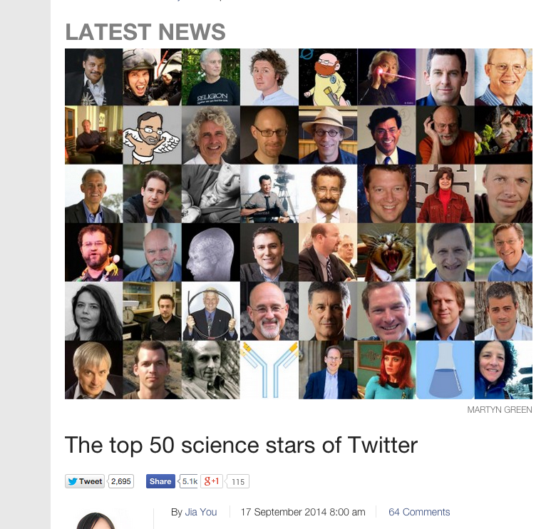

Slide 18
From outreach to science tool
Altmetrics provide us with a way of quantifying community connection and involvement
Are they enough, given peer-to-peer use of alternative media?
How do they fit into the standard narrative of review and credit?

Slide 19
Thank you

